Slide 1
Draft Resolution 3.3.1/1 (RA VI-19(I)) Establishing Regional WMO Integrated Global Observing System (WIGOS) Centres in Region VI in pilot mode

Slide 2
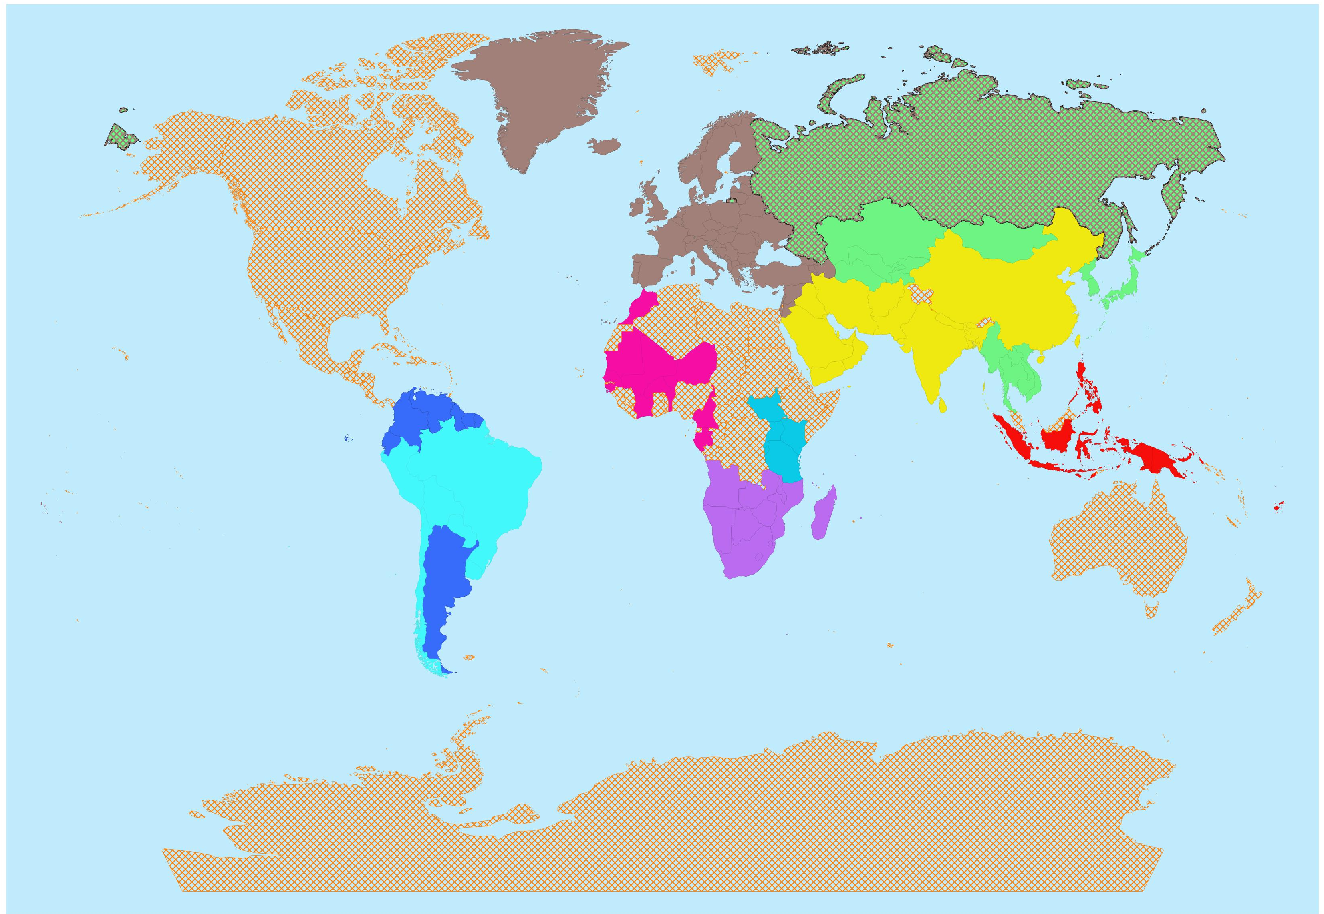
Regional Implementation of WIGOS
Status of RWCs establishment
RA IV:
Started pilot phase in Dec 2023 (BCT, Canada, Costa Rica, Trinidad & Tobago, USA)
RA VI:
New concept approved and pilot phase started in July 2024, with nodes hosted by Bosnia & Herzegovina, Romania, Türkiye and EUMETNET, plus Kazakhstan, Russian Federation and Belarus
RA III:
Pilot phase operations since May 2020 (Argentina and Brazil)
RA I:
East Africa - Pilot phase since July 2020 (Kenya and Tanzania),
Southern Africa - pilot phase since March 2021 (South Africa)
West/Central Africa – new concept approved to implement by end 2024
RA V:
Initial pilot phase since October 2022 (Indonesia and Fiji)
RA II
RWC Beijing and RWC Tokyo, fully operational since September 2021
Antarctica

Slide 3
Distribution of functions and Members affiliations (May 2024, updated July 2024)
RWC | Bosnia and Herzegovina | Kazakhstan, Russian Federation and Belarus | Romania | Türkiye | EUMETNET
Functions | Metadata&WDQMS | Metadata&WDQMS | Metadata&WDQMS | Metadata&WDQMS | Metadata&WDQMS
Proposed Affiliated Members | 1. Albania 2. Bulgaria 3. Türkiye | 1. Armenia 2. Belarus 3. Russian Federation 4. Kazakhstan* 5. Kyrgyzstan* 6. Turkmenistan* 7. Tajikistan* 8. Uzbekistan* | 1. Republic of Moldova 2. Ukraine 3. Monaco 4. Andorra 5. Syrian Arab Republic 6. Israel | 1.Azerbaijan 2. Georgia 3. Jordan 4. Lebanon 5. Bosnia and Herzegovina | EUMETNET Members
* Currently covered by RA II RWCs

Slide 4
Background / Justification
Recalling:
Resolution 4 (INFCOM-3), Resolution 5 (INFCOM-3), and Resolution 13 (EC-78)
Recognizing:
Critical role of RWCs in advancing regional coordination, guidance, oversight, and support for WIGOS implementation and operational activities at the regional and national levels.
Existence and work of RWCs in RA II (Asia) and encouraging RA VI (Europe) to further cooperate with RA II in RWC matters.
Noting:
All Members in RA VI were informed in advance of the concept and process of establishment of RA VI RWCs, including endorsement by the RA VI Management Group.
RWC Concept and RWC Implementation Plan for RA VI (information document).

Slide 5
Action(s) required
Decides:
To confirm designation of the following Members/Organizations as Regional WIGOS Centres nodes in RA VI in pilot mode for carrying out the mandatory functions of the RWCs:
EUCOS (The EUMETNET Composite Observing System) Observing Monitoring Facility operated under the EUMETNET Observations Programme
Bosnia and Herzegovina
Kazakhstan, Russian Federation, and Belarus
Romania
Türkiye
Urges Members:
To collaborate with the RWC nodes to ensure that their terms of reference are met.
To nominate or update, their National Focal Points (NFPs) on WIGOS, NFPs on OSCAR/Surface and NFPs on WIGOS Data Quality Monitoring System (WDQMS).

